Slide 1
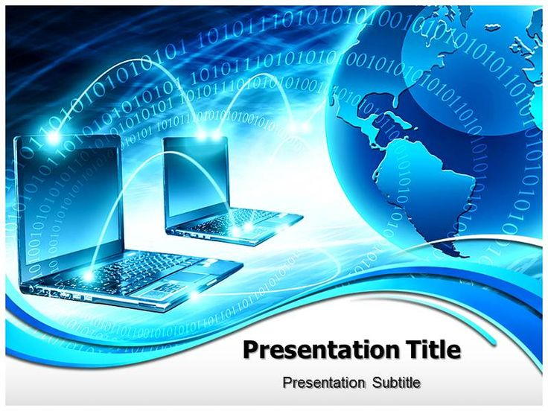
Computer

Slide 2
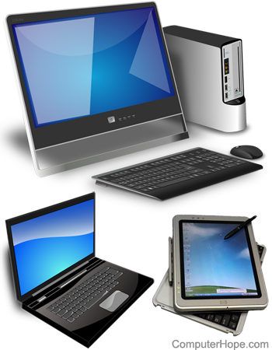
What is computer
A computer is a programmable device that stores, retrieves, and processes data. The term "computer" was originally given to humans (human computers) who performed numerical calculations using mechanical calculators, such as the abacus and slide rule. The term was later given to mechanical devices as they began replacing human computers. Today's computers are electronic devices that accept data (input), process that data, produce output, and store (storage) the results (IPOS).

Slide 3
Functionalities of a computer
Any digital computer carries out five functions in gross terms: Takes data as input. Stores the data/instructions in its memory and use them when required. Processes the data and converts it into useful information. Generates the output Controls all the above four steps

Slide 4
Computer Components
* Hardware
* software

Slide 5
Hardware Computer
*
hardware is the collection of physical elements ”Tangible objects ” that constitutes a computer system . The actual machinery, wires, transistors, and circuits … etc.

Slide 6
Software computer
*
Software, instructions that tell a computer what to do. Software comprises the entire set of programs, procedures, and routines associated with the operation of a computer system. The term was coined to differentiate these instructions from hardware—i.e., the physical components of a computer system.

Slide 7
Types of Computers
*
*Super Computer
*Mainframe computer
*Mini Computer
*Workstation Computer
*Personal Computer (PC)
*Server Computer
*Analog Computer
*Digital Computer
*Hybrid Computer
*Tablets and Smartphone

Slide 8
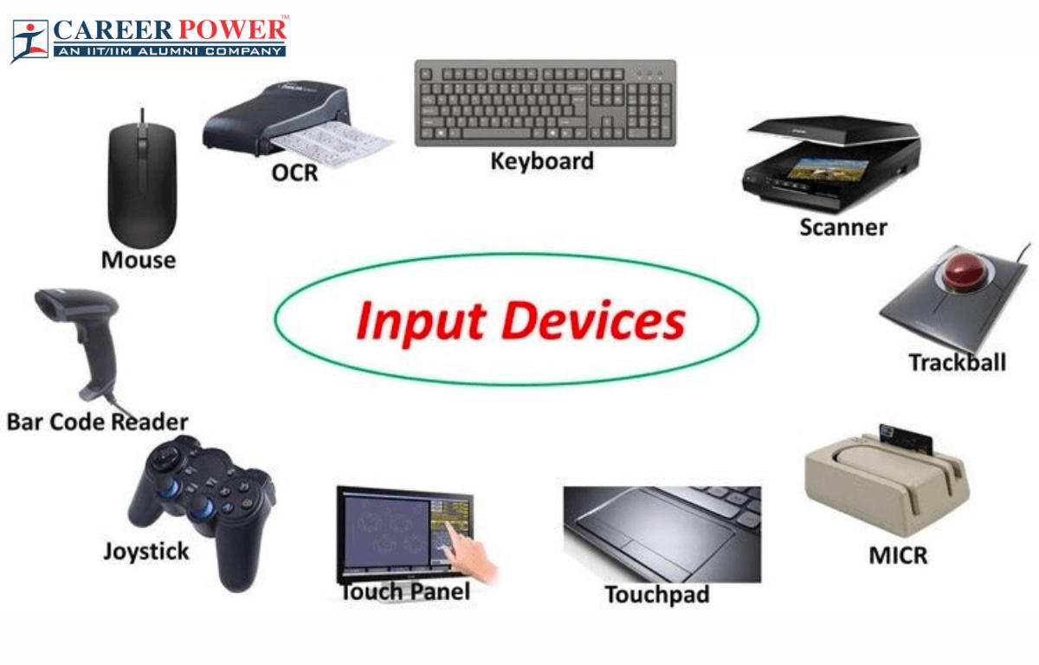
Input Device
In computing, an input device is a piece of equipment used to provide data and control signals to an information processing system, such as a computer or information appliance. Examples of input devices include keyboards, computer mice, scanners, cameras, joysticks, and microphones.

Slide 9
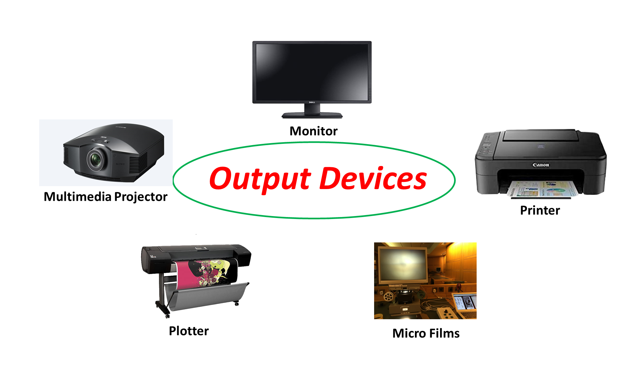
Output device
An output device is any piece of computer hardware that converts information or data into a human-perceptible form or, historically, into a physical machine-readable form for use with other non-computerized equipment. It can be text, graphics, tactile, audio, or video. Examples include monitors, printers, speakers, headphones, projectors, GPS devices, optical mark readers, and braille readers.

Slide 10
Usage of computer
Computer is the best companion of our daily life
* Network attached strong
*Media server
*graphics designs
*online banking
*gaming
*social networking
*knowledge sharing

Slide 11


